Slide 1
STRATEGY PATTERN
A patterns-box talk
by
Jose Palacios

Slide 2
About me
Hi, I’m Jose, Software Engineer 3 at Belatrix. Currently I’m working at La Familia Team on the convertion modules

Slide 3
01
02
03
04
Goal
Real world case
Architecture
Problems it solves

Slide 4
05
06
07
08
When to use it?
When not to use it?
Common mistakes
Advantages

Slide 5
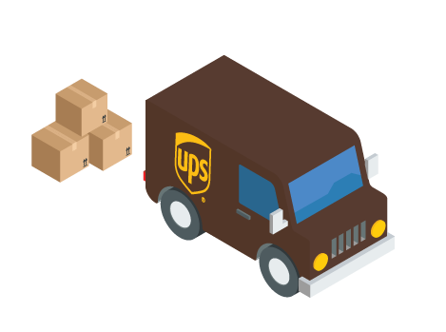
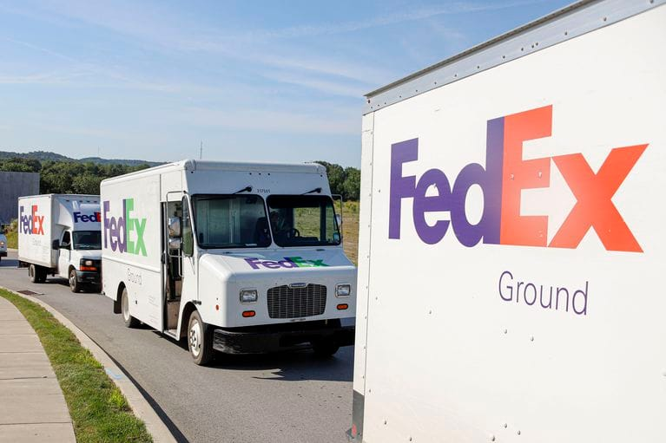

Real world case

Slide 6
Goal
Define a family of algorithms, encapsulate each one, and make them interchangeable. Strategy lets the algorithm vary independently from clients that use it.

Slide 7
Architecture
Context
Interface
(IShippingCalculation)
Concrete Strategies
FedExStrategy
7.5 * km
UPSStrategy
5 * km

Slide 8

Problems it solves
Exchanging methods, behaviours at run-time
Inflexible code
Duplicated code

Slide 9
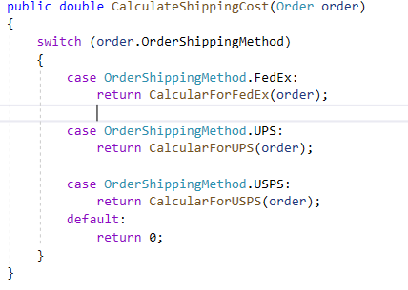
When to use it?
When you need to use several algorithms with different variations.
When you have to add new behaviours to an object
When most of your classes have related behaviours.

Slide 10
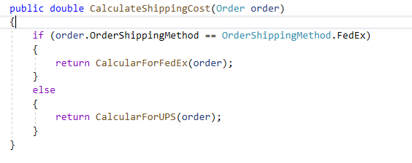
When not to use it?
When new behaviours will not be added to the class

Slide 11

Common mistakes
Forcing the pattern

Slide 12

Advantages
Single Responsibility Principle.
Open/Closed Principle.
Clean code
Testability
Cyclomatic complexity

Slide 13
Demo

Slide 14

Thanks

